Slide 1
FILE HANDLING
CICS Training Class-08

Slide 2



Types of VSAM Cluster
Types of VSAM datasets used in CICS are:
Entry Sequenced Dataset (ESDS) RBA SEQ/RDM
Key Sequenced Dataset (KSDS) KEY SEQ/RDM
Relative Record Dataset (RRDS) RRN SEQ/RDM
DTATSET TYPE
ACCESSED USING
ACCESS MODE

Slide 3
Services Provided By CICS
Basic Operation Required For A File Are
  Adding A Record
  Modifying A Existing Record
  Deleting A Existing Record
  Browsing One Or All Records
  Reading A Record
Addition CICS Provides
  Exclusive Control On Record Level
  Opening And Closing
  Journaling

Slide 4
Defining A File To CICS
File should be defined in FCT ( File Control Table)
FCT will contain all the information about a file ( Like dataset name , access methods, permissions etc.)
Defining file can be done either by CEDA transition or DFHFCT macro
CEDA DEF FILE(FILE-NAME) G(G-NAME)
CEDA INS FILE(FILE-NAME) G(G-NAME)

Slide 5
File Handling In Program
File should not be defined in program
Program should not open or close a file
Records can be inserted updated or deleted

Slide 6
Sequential Read
Sequential read is done by Browse Operation
Established the pointer to the first record to read using STARTBR
Next and previous records can be read as required using READNEXT and READPREV.
End the browse operation at last Using ENDBR
Browse can be re-positioned USING RESETBR
During browse operation records cannot be updated

Slide 7
STARTBR Command
      EXEC CICS STARTBR
        FILE(FILENAME)
        RIDFLD(DATA-AREA)
      END-EXEC.
Condition : DISABLED , IOERR , NOTFND, NOTOPEN

Slide 8
READING AFTER STARTBR
Sequentially The Next And Previous Record Can Be Read By A READNEXT Or READPREV
The First READNEXT Or READPREV Will Read The Record Where The STARTBR Has Positioned The File Pointer
READNEXT Followed By READPREV Or Vice Versa Operation Will Always Read The Same Record

Slide 9
READNEXT/ READPREV
      EXEC CICS READNEXT | READPREV
        FILE(NAME)
        INTO(DATA-AREA)
        RIDFLD(DATA-AREA)
      END-EXEC.
Conditions : DUPKEY ENDFILE IOERR LENGERR NOTFND

Slide 10
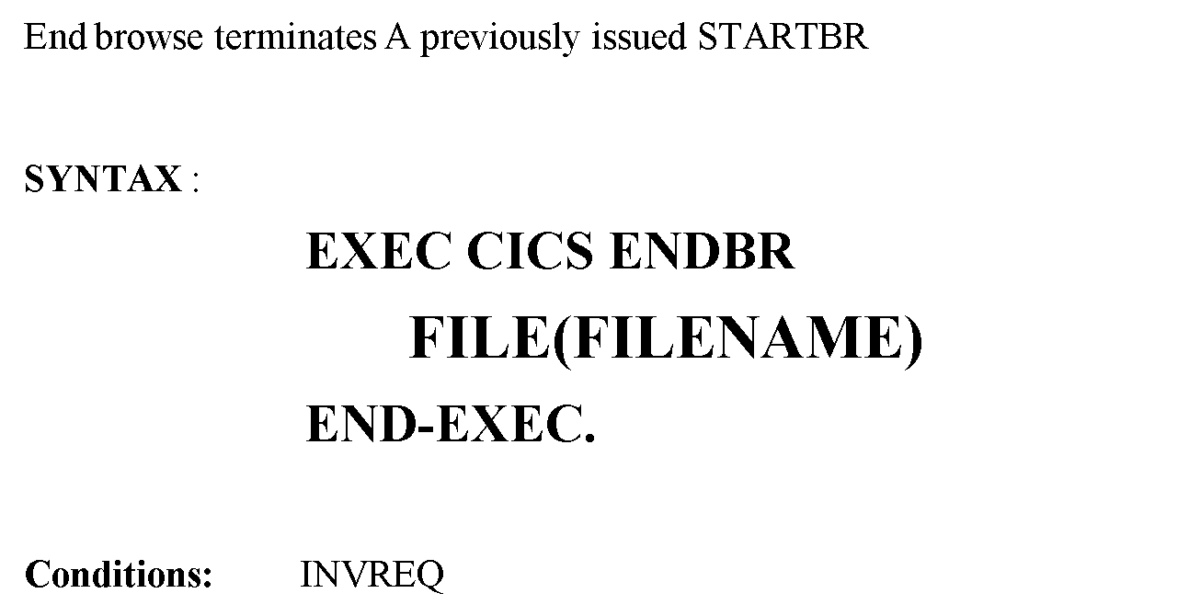
ENDBROWSE

Slide 11
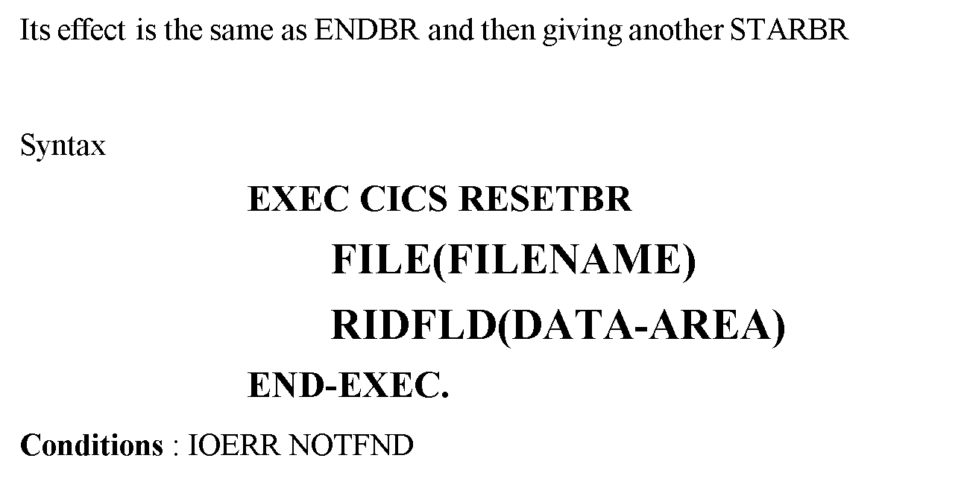
RESETBR

Slide 12
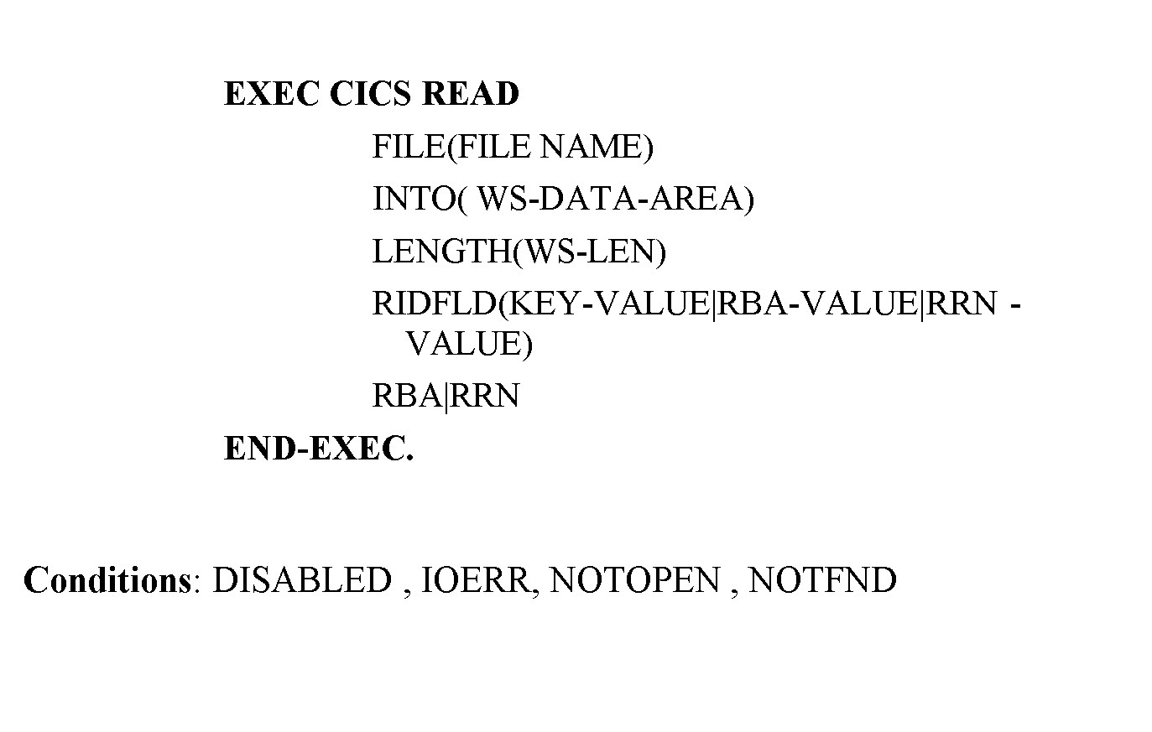
READ Command

Slide 13
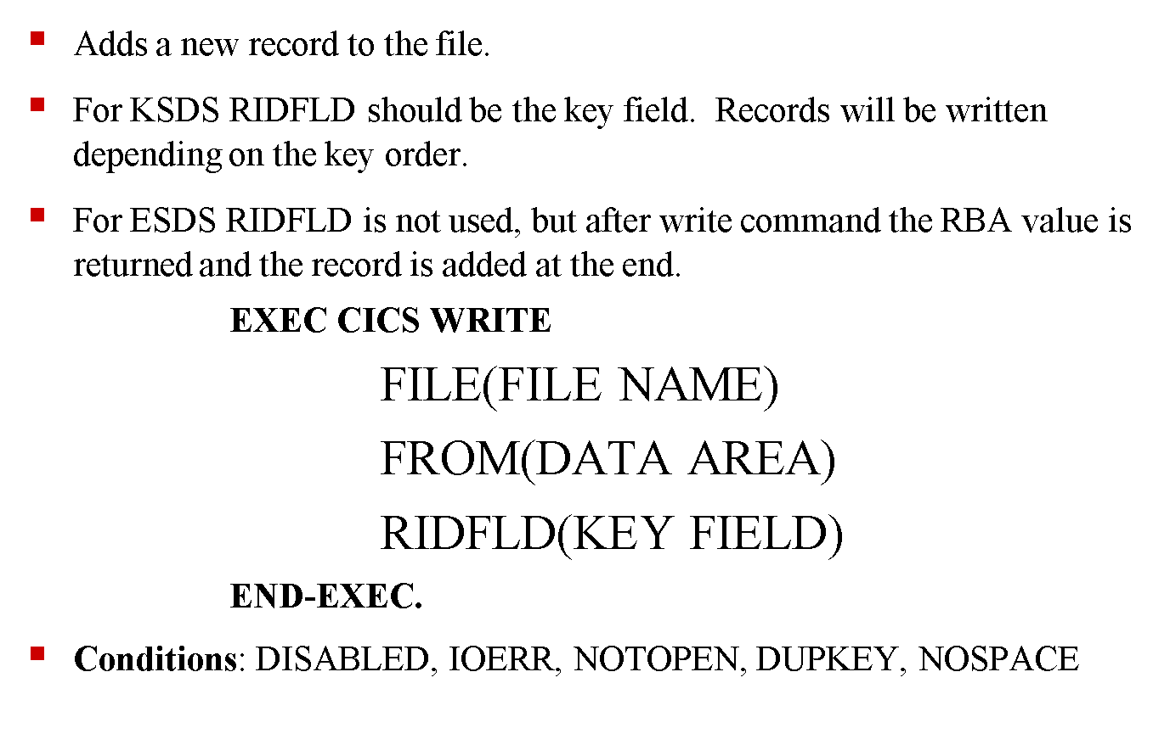
WRITE Command

Slide 14
REWRITE Command
Used to update a record which is previously read with update option
Rewrite automatically unlocks the record after execution
  EXEC CICS READ FILE(FILE NAME) …… UPDATE END-EXEC.
      EXEC CICS REWRITE
        FILE(FILE NAME)
        FROM( DATA AREA)
      END-EXEC.
Conditions: DISABLED , IOERR, NOSAPCE LENGERR

Slide 15
Delete Command
Delete’s a record from the file
Record can be deleted in two ways
  Randomly with RIDFLD having full key
  Record read with UPDATE command one by one
Multiple records can be deleted by providing Generic option
      EXEC CICS DELETE
      FILE(FILE NAME)
      RIDFLD(DATA-AREA)
      END-EXEC
Conditions : DISABLED. IOERR, NOTOPEN, NOTFND

Slide 16
UNLOCK Command
TO RELEASE the record which has been locked by read with UPDATE command
Syntax:
        EXEC CICS UNLOCK
        FILE(FILENAME)
        END-EXEC.
Conditions : IOERR, INVREQ

Slide 17
Thank You
Polsani Anil Kumar

